Slide 1
INTRODUCTION TO
ALGORITHMS
FOURTH EDITION

Slide 2
LECTURE NOTES FOR CHAPTER 7
Quicksort

Slide 3
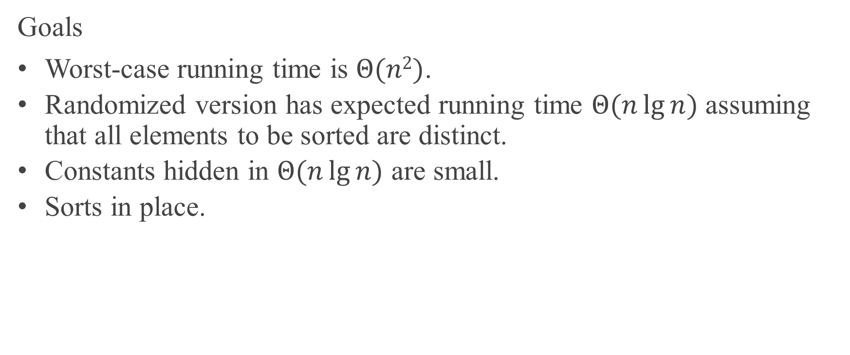
CHAPTER 7 OVERVIEW
Goals
Worst-case running time is $Θ(n2)$.
Randomized version has expected running time $Θ(n\lg{n})$ assuming that all elements to be sorted are distinct.
Constants hidden in $Θ(n\lg{n})$ are small.
Sorts in place.

Slide 4
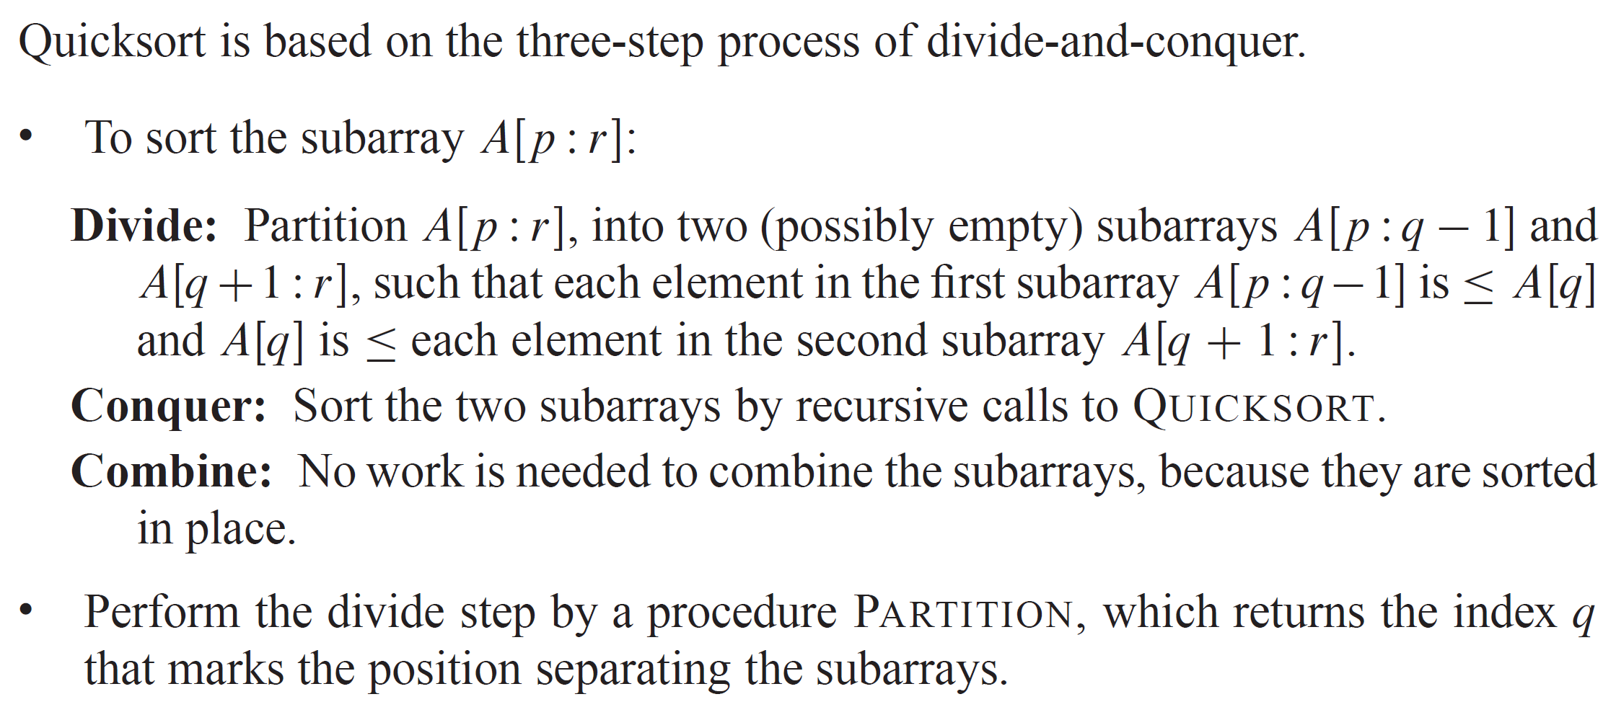
DESCRIPTION OF QUICKSORT

Slide 5
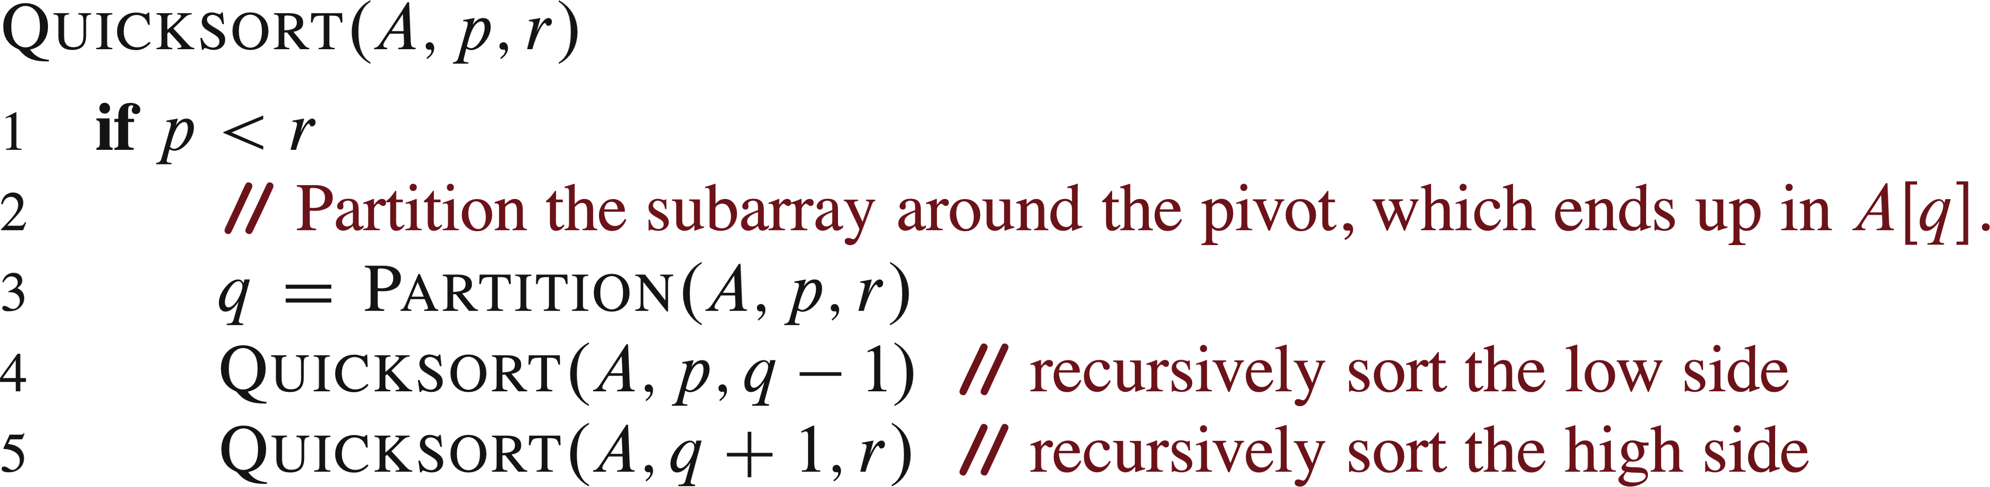
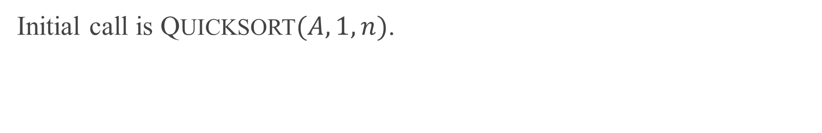
PSEUDOCODE
Initial call is QUICKSORT$(A,1,n)$.

Slide 6
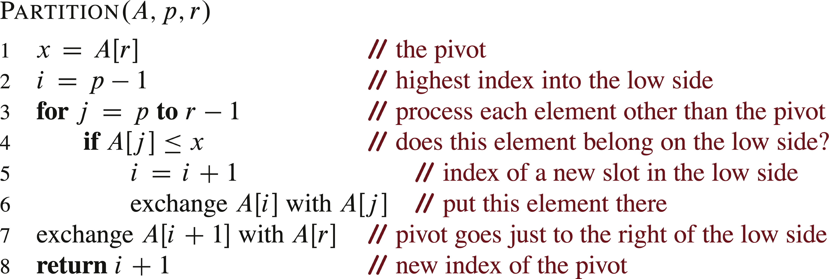
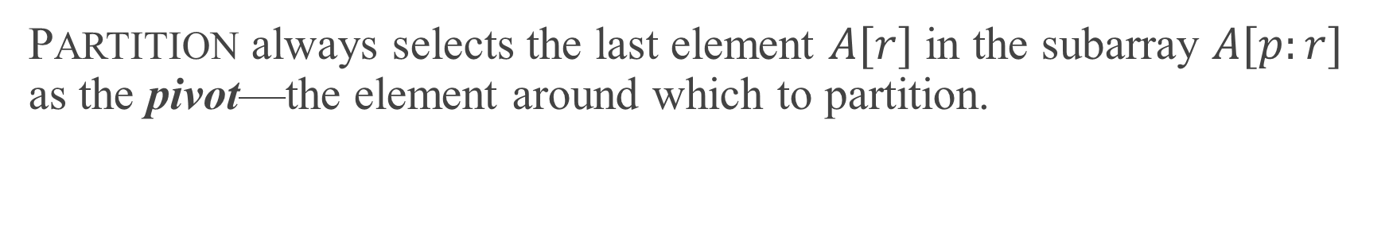
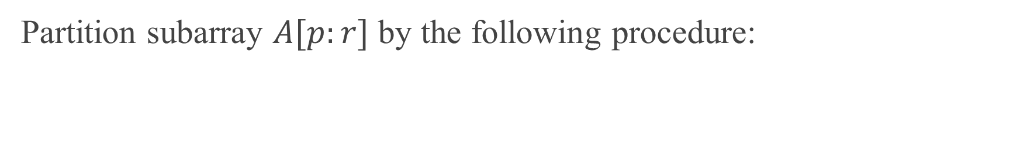
PARTITIONING
Partition subarray $A[p:r]$ by the following procedure:
PARTITION always selects the last element $A[r]$ in the subarray $A[p:r]$ as the pivot—the element around which to partition.

Slide 7
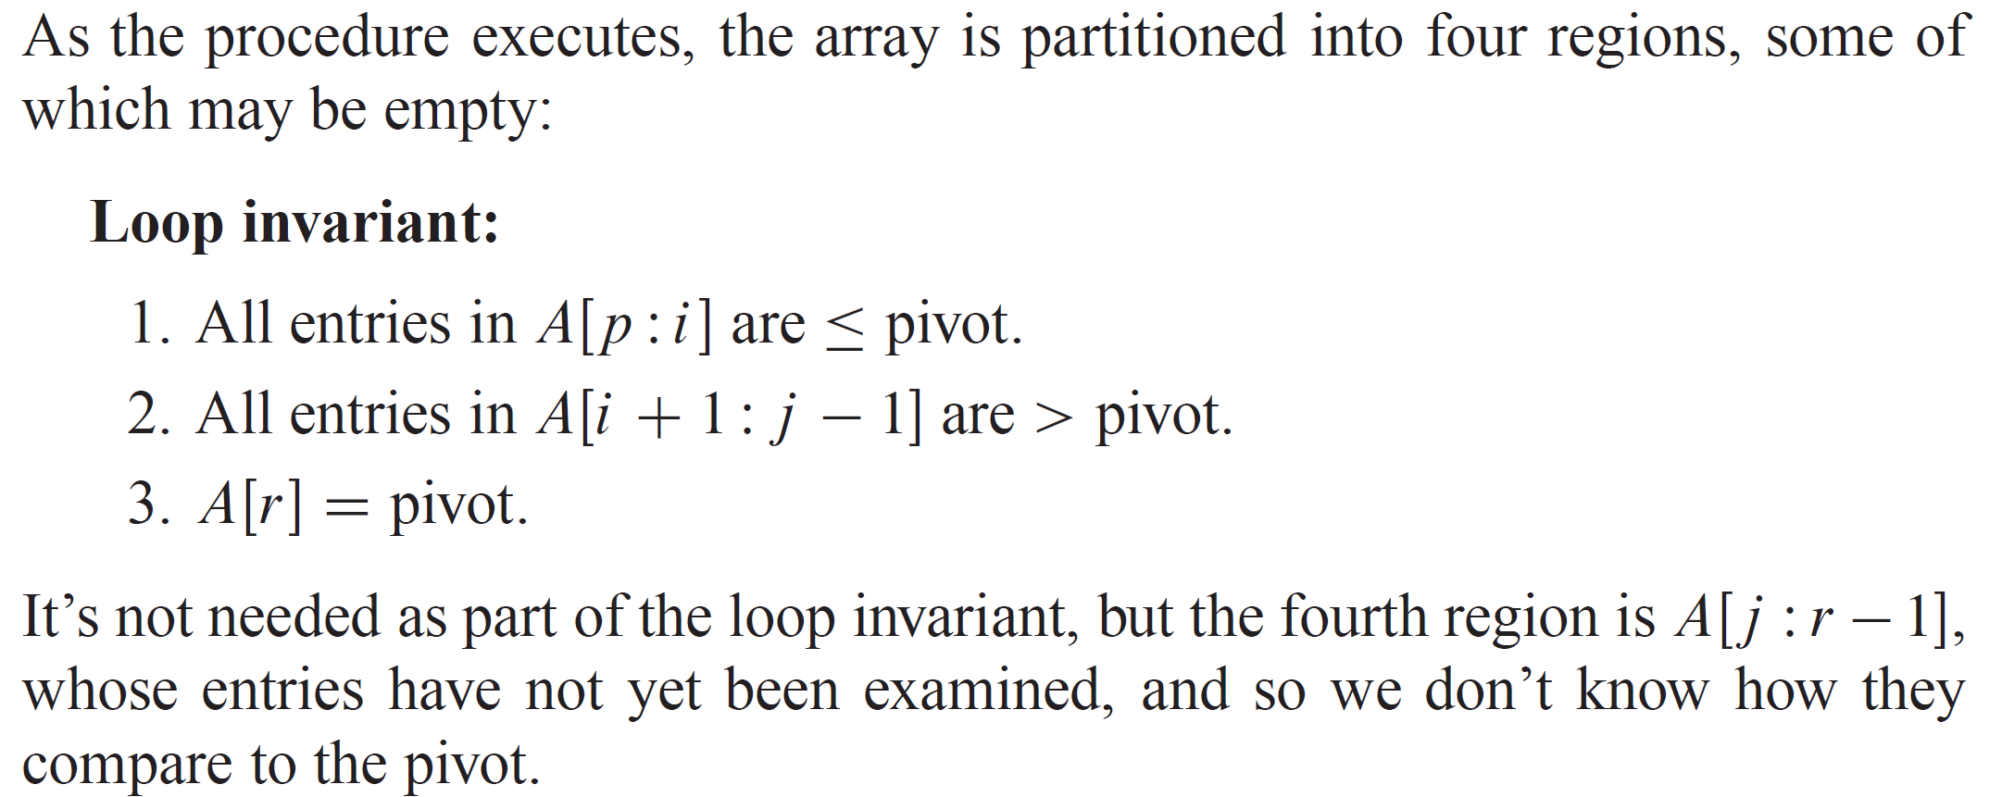
PARTITIONING (continued)

Slide 8
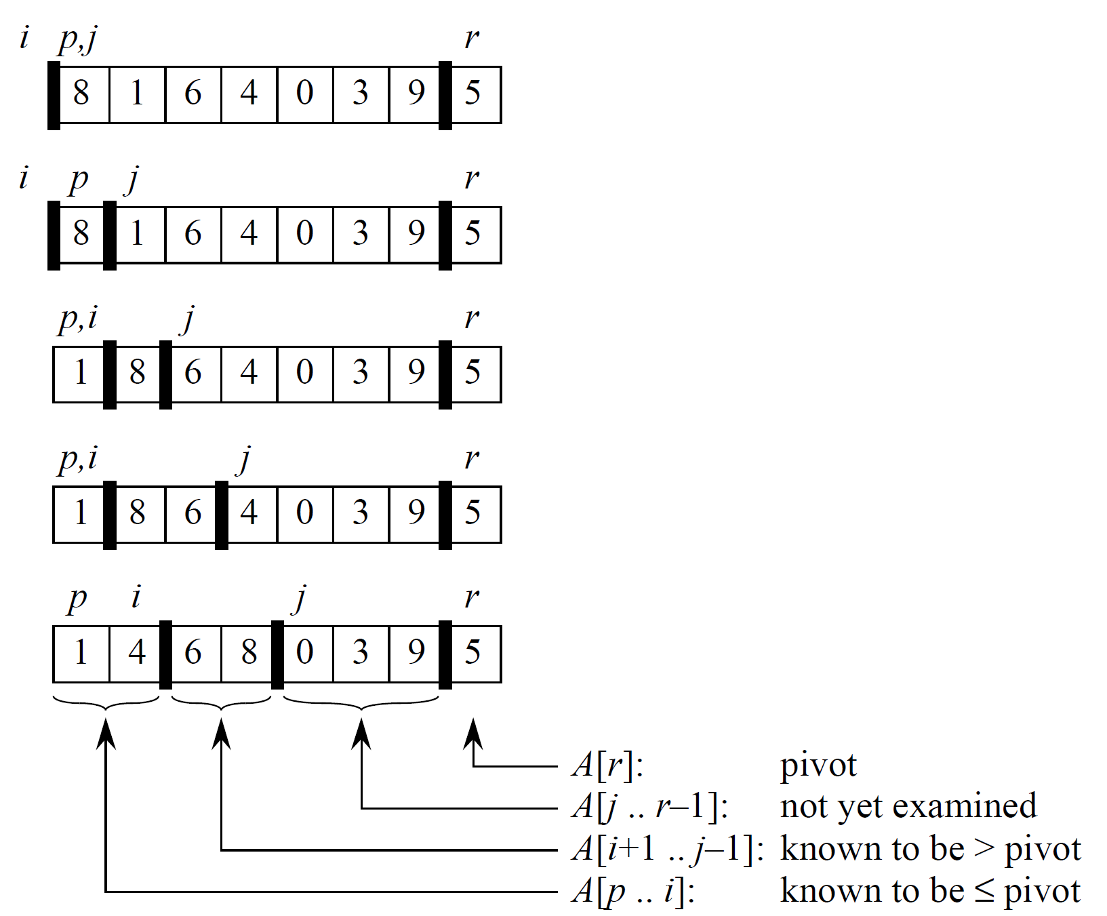





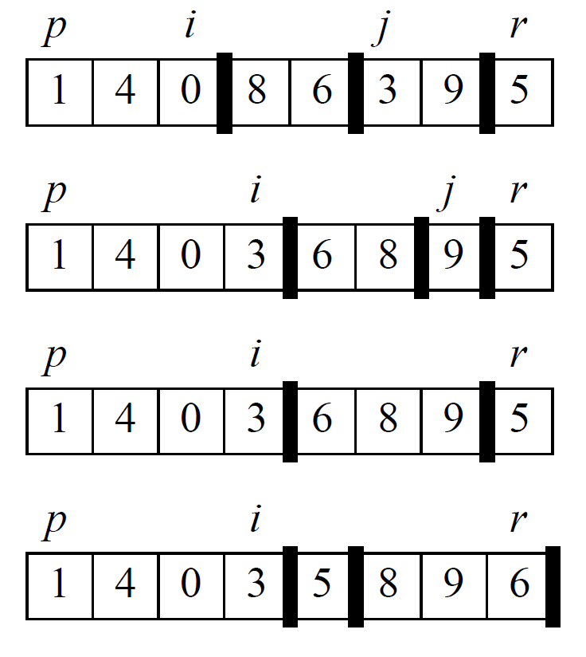



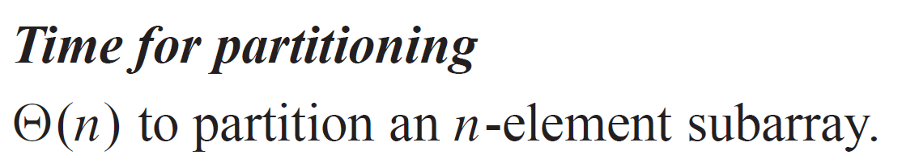

EXAMPLE

Slide 9
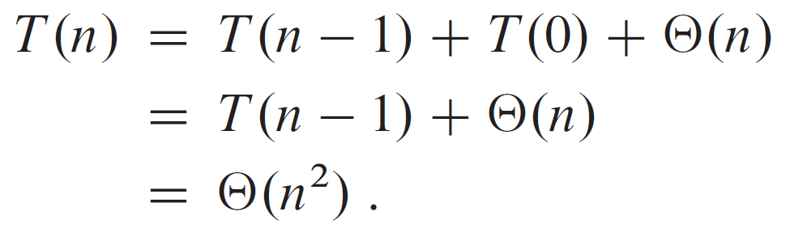
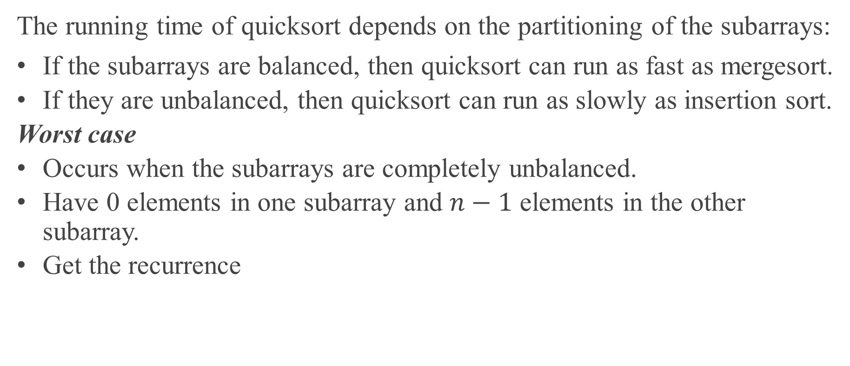
PERFORMANCE OF QUICKSORT
The running time of quicksort depends on the partitioning of the subarrays:
If the subarrays are balanced, then quicksort can run as fast as mergesort.
If they are unbalanced, then quicksort can run as slowly as insertion sort.
Worst case
Occurs when the subarrays are completely unbalanced.
Have 0 elements in one subarray and $n−1$ elements in the other subarray.
Get the recurrence

Slide 10
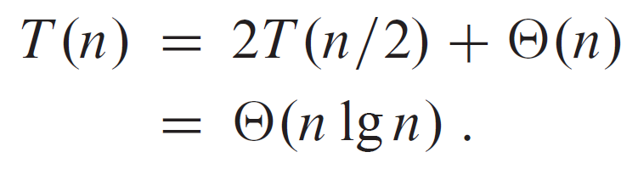

PERFORMANCE OF QUICKSORT (continued)
Best case
Occurs when the subarrays are completely balanced every time.
Each subarray has $≤n/2$ elements.
For an upper bound, get the recurrence

Slide 11
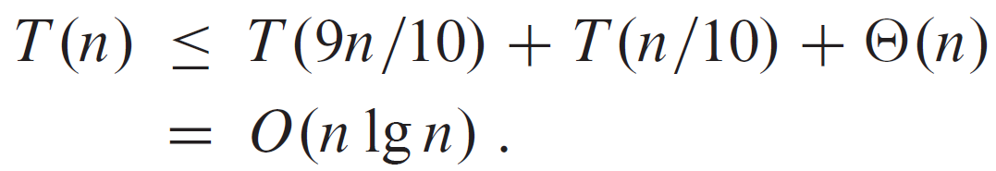
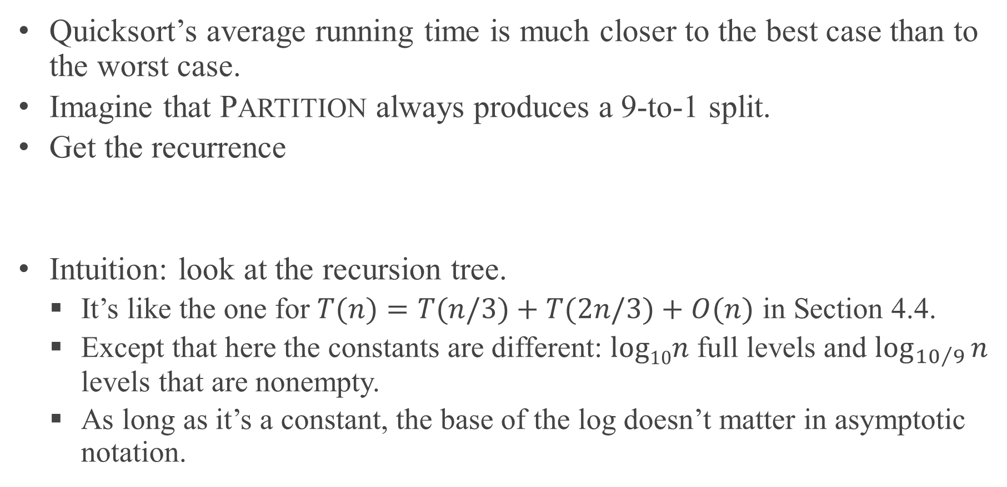
BALANCED PARTITIONING
Quicksort’s average running time is much closer to the best case than to the worst case.
Imagine that PARTITION always produces a 9-to-1 split.
Get the recurrence
Intuition: look at the recursion tree.
It’s like the one for $T(n)=T(n/3)+T(2n/3)+O(n)$ in Section 4.4.
Except that here the constants are different: $log10n$ full levels and $\log_{{10}/9}{n}$ levels that are nonempty.
As long as it’s a constant, the base of the log doesn’t matter in asymptotic notation.

Slide 12
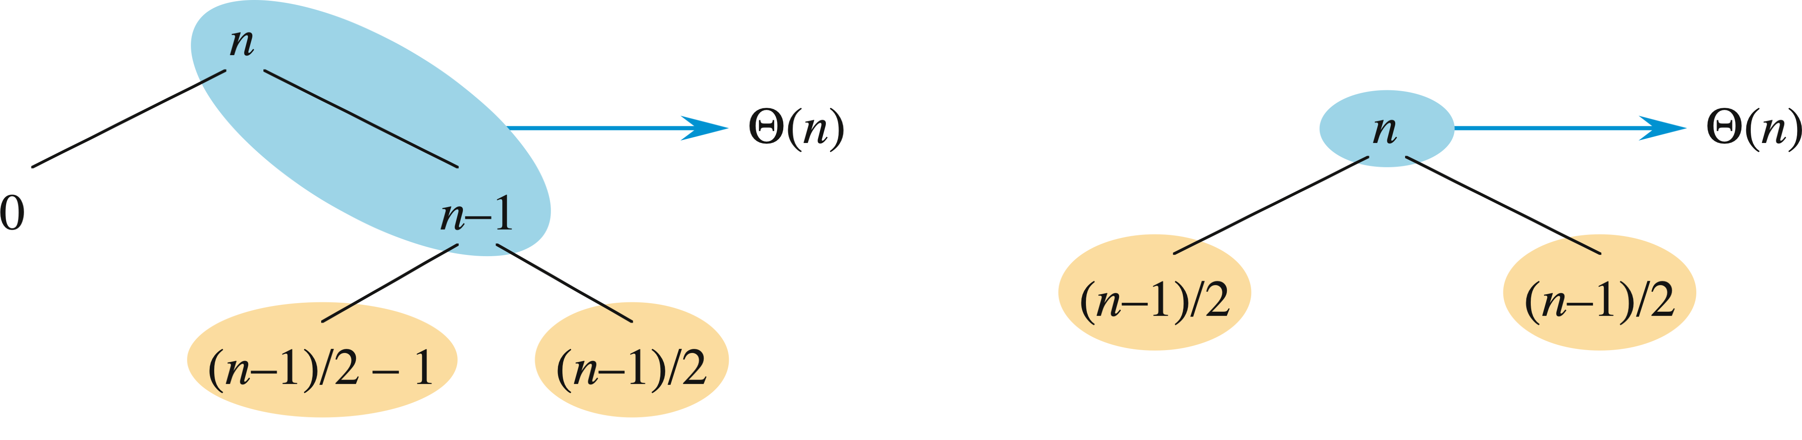
INTUITION FOR THE AVERAGE CASE
Splits in the recursion tree will not always be constant.
There will usually be a mix of good and bad splits throughout the recursion tree.
To see that this doesn’t affect the asymptotic running time of quicksort, assume that levels alternate between best-case and worst-case splits.
The extra level in the left-hand figure only adds to the constant hidden in the Θ-notation.
There are still the same number of subarrays to sort, and only twice as much work was done to get to that point.

Slide 13
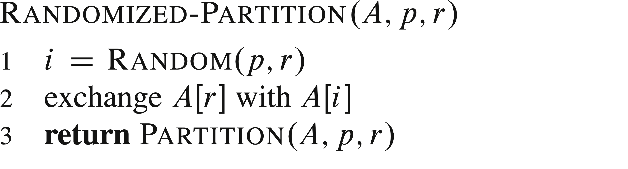
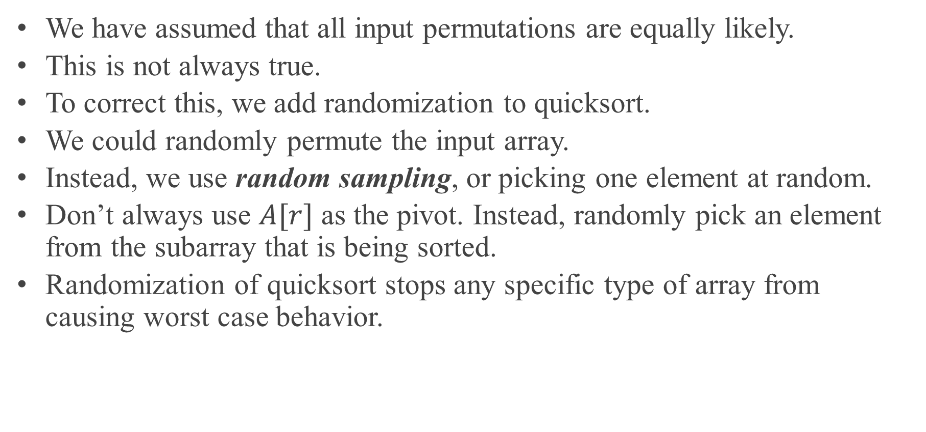
RANDOMIZED VERSION OF QUICKSORT
We have assumed that all input permutations are equally likely.
This is not always true.
To correct this, we add randomization to quicksort.
We could randomly permute the input array.
Instead, we use random sampling, or picking one element at random.
Don’t always use $A[r]$ as the pivot. Instead, randomly pick an element from the subarray that is being sorted.
Randomization of quicksort stops any specific type of array from causing worst case behavior.

Slide 14
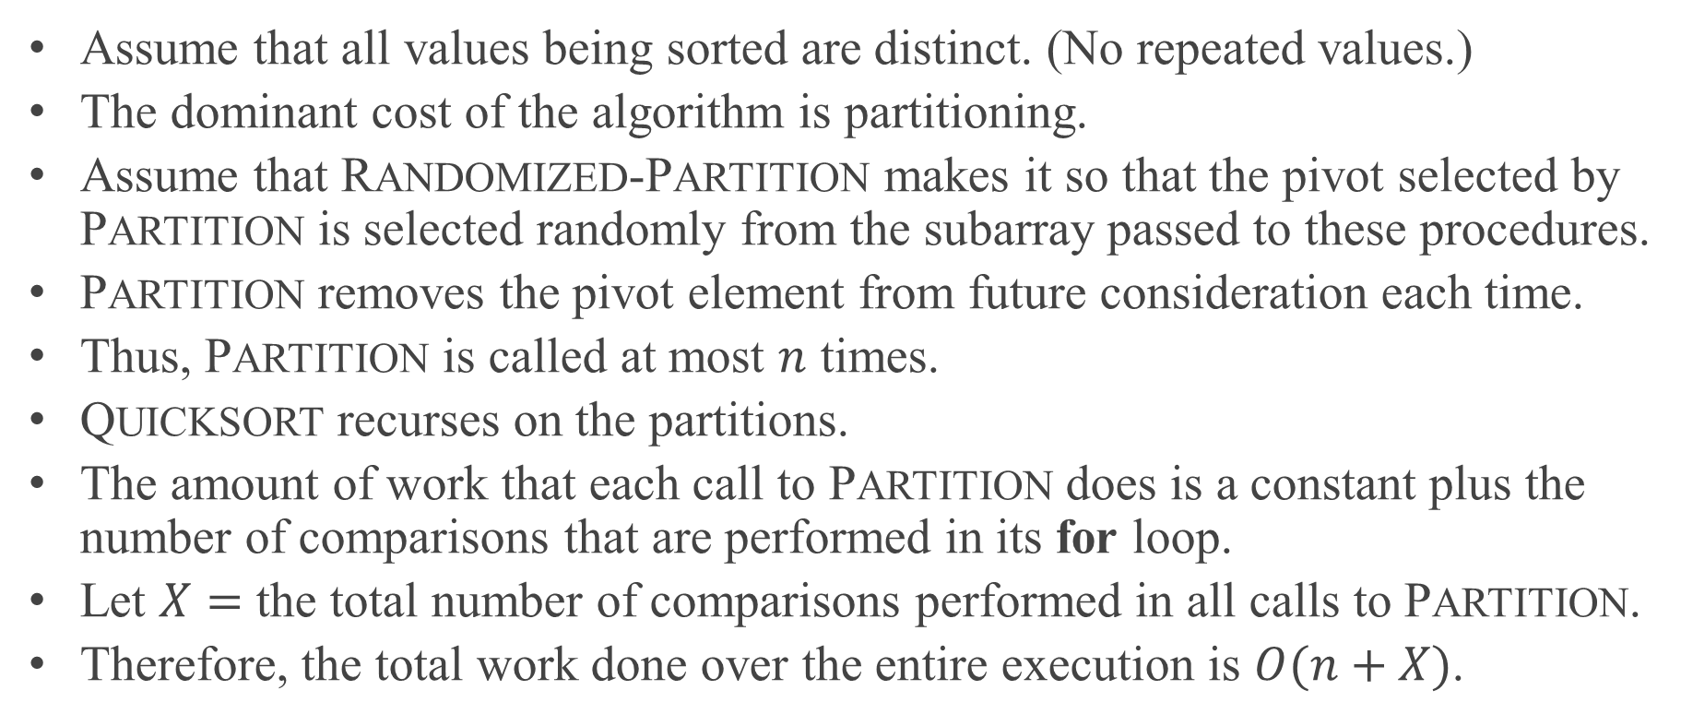
AVERAGE-CASE ANALYSIS
Assume that all values being sorted are distinct. (No repeated values.)
The dominant cost of the algorithm is partitioning.
Assume that RANDOMIZED-PARTITION makes it so that the pivot selected by PARTITION is selected randomly from the subarray passed to these procedures.
PARTITION removes the pivot element from future consideration each time.
Thus, PARTITION is called at most $n$ times.
QUICKSORT recurses on the partitions.
The amount of work that each call to PARTITION does is a constant plus the number of comparisons that are performed in its for loop.
Let $X=$ the total number of comparisons performed in all calls to PARTITION.
Therefore, the total work done over the entire execution is $O(n+X)$.

Slide 15
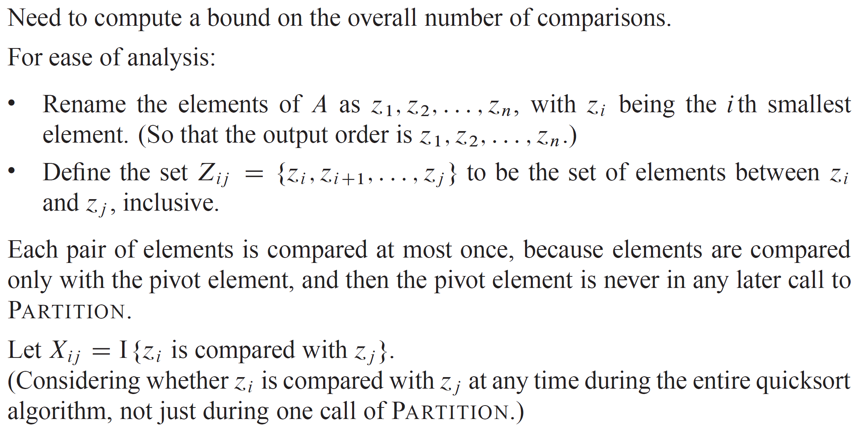
AVERAGE-CASE ANALYSIS (continued)

Slide 16
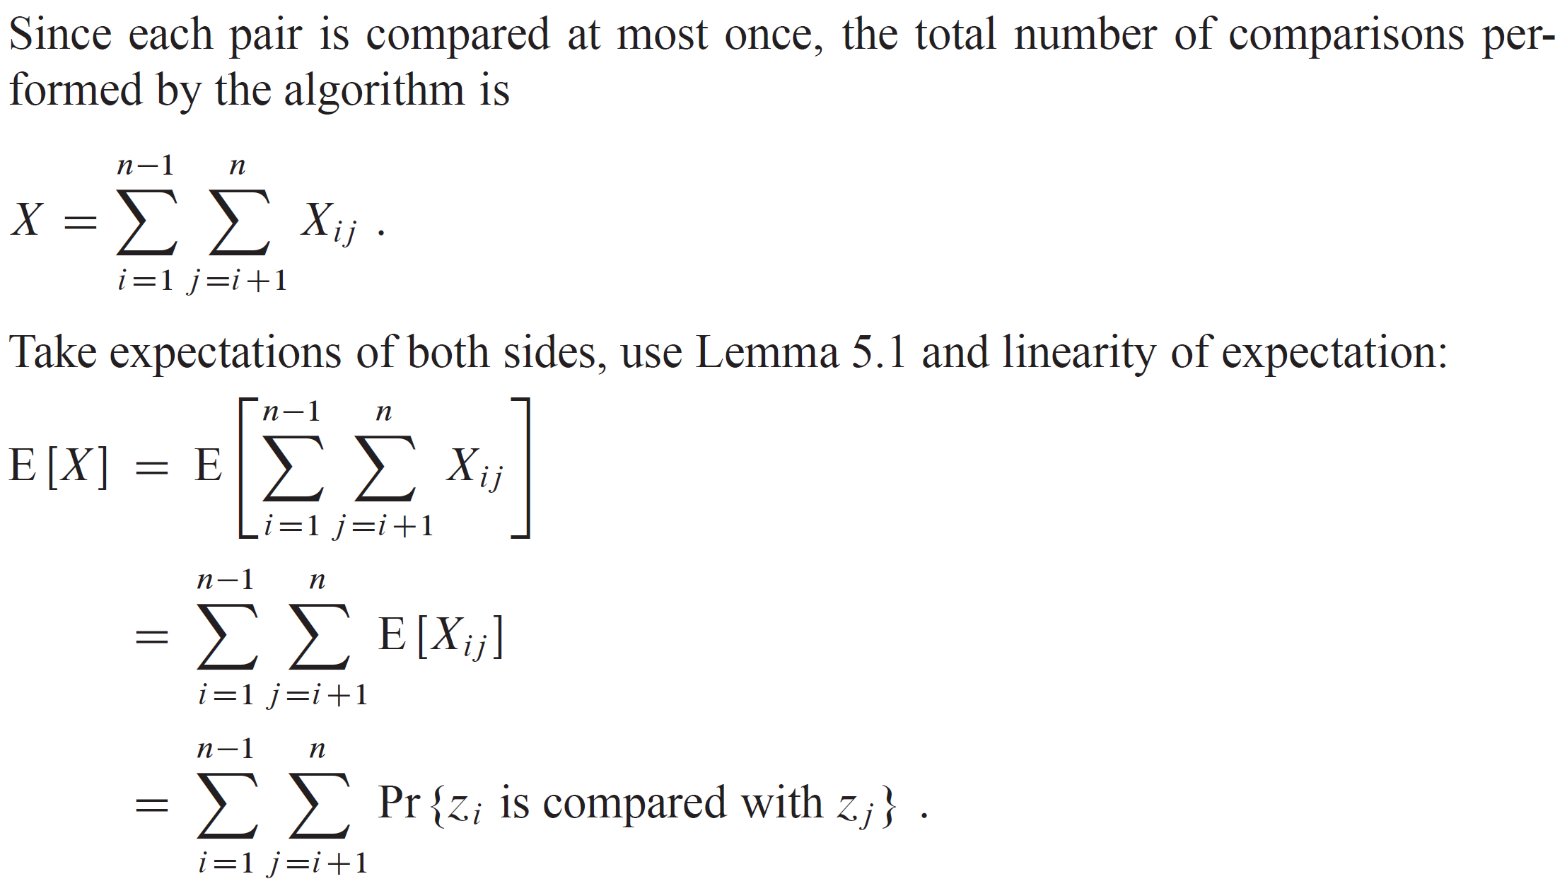
AVERAGE-CASE ANALYSIS (continued)

Slide 17
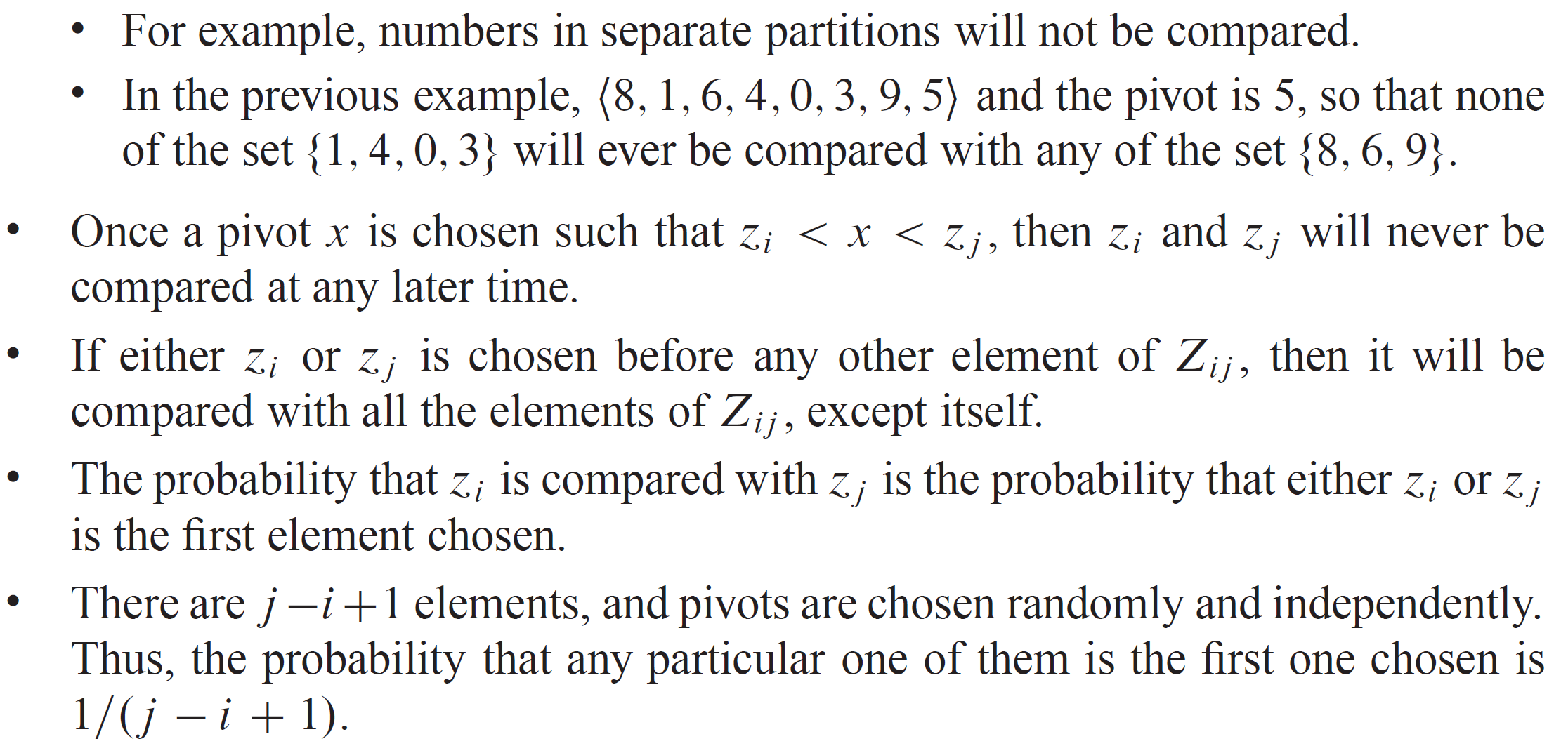
AVERAGE-CASE ANALYSIS (continued)
Now all we have to do is find the probability that two elements are compared.
Think about when two elements are not compared.

Slide 18
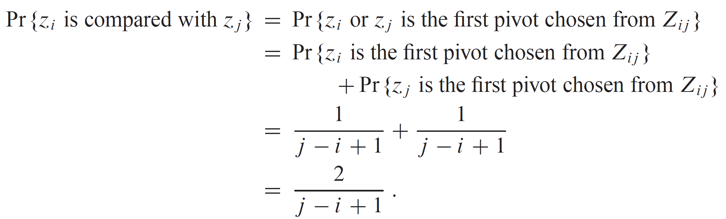
AVERAGE-CASE ANALYSIS (continued)

Slide 19
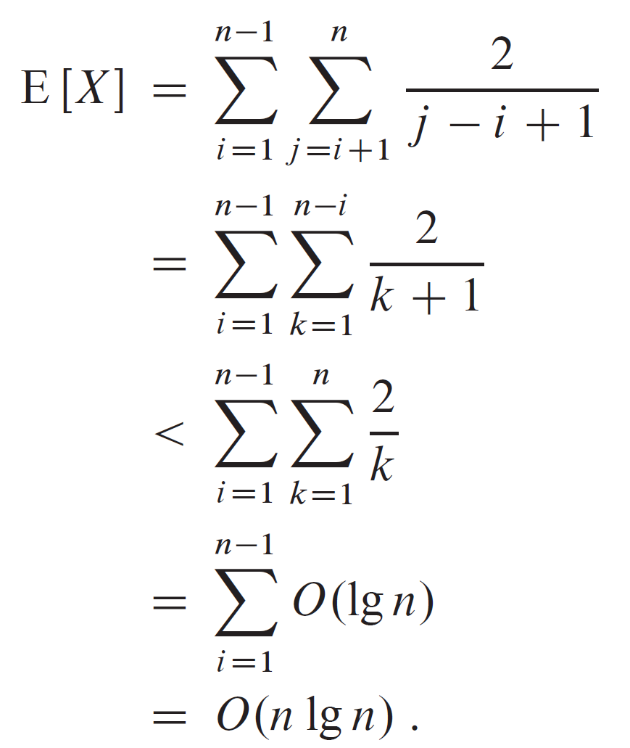
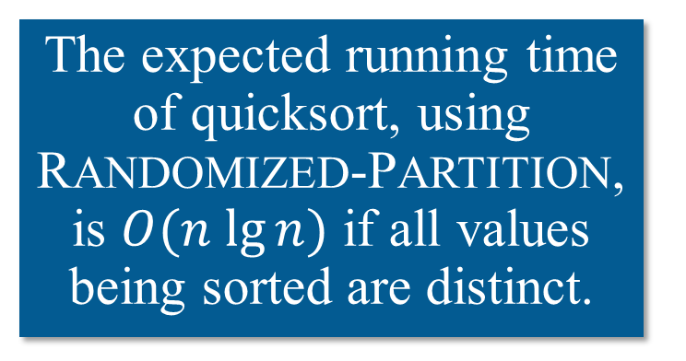
AVERAGE-CASE ANALYSIS (continued)
The expected running time of quicksort, using RANDOMIZED-PARTITION, is $O(n lg⁡n)$ if all values being sorted are distinct.

